Slide 1
Presentation Format
Title slide – motivation (increased media attention makes it seems like nation wide shootings are increasing), hypothesis (pose questions to audience in first slide), questions asked and if we could answer them (same questions we have asked you we asked ourselves?)
Questions and Data – what kind of data did we need (? Where did you get it? (data.gov and Kaggle.com)
Data cleanup and exploration – insights of data we weren’t expecting, problems and how we solved, present interesting figures with Jupyter notebook
Analysis – steps to analyze the data and answer our questions. Discuss interesting figures found during analysis (x)
Discussion around findings – hypothesis true or false? Surprising, why or why not?
Difficulties and what other data we would analyze if we had more time.
At ten minutes each we should average two minutes per group.
Notes:
Title slide -

Slide 2
Why did people protest in Charlotte in the fall of 2016?
Keith Lamont Scott was shot in September 2016 by CMPD sparking city wide protests and nationwide media attention.
Notes:
Pose Questions:
Does anyone remember why there were protests in and around Charlotte in September of 2016?
Yes! Keith Lamont Scott was shot by CMPD officers sparking city wide protests and nationwide media attention.

Slide 3
Four key questions
Do you believe shootings increase or decrease with age?
Do you believe Charlotte is consistent with the national shootings overall?
Do you believe wealthy neighborhoods have fewer police shootings?
Do you believe areas where community police interaction is greater results in less police shootings?
Notes:
Pose Questions:
Do you guys believe the crime rate increases or decreases with age?
Do you think Charlotte is consistent with the US police involved shootings overall?
Do you believe wealthy neighborhoods are safer?
Do you believe areas where police interaction within the community are safer?

Slide 4
Police Shooting Demographics vs. Police Outreach
Colleen Karnas-Haines, Corey Plott, Deanna Ryder, Tushaar Bedi
Notes:
Name of project and group members (done).
Data – what kind of data did we need (we needed all data around police shootings at a national level and Charlotte level. Where did we get it? (data.gov and Kaggle.com)
The increased police involved shootings nation wide sparked curiosity within our group to understand how Charlotte compared to the national average, but also to quantify the amount of police shootings where police outreach was robust. We pulled shooting (national and Charlotte level) data from Data.gov using Python to clean, structure and present our data for you tonight. Before we dove into the data we asked ourselves a few questions:
1.

Slide 5
Data sources:
Kaggle.com
Data.gov
APIs:
Google Maps
Data.gov
Libraries:
Pandas
Numpy
Matplot Lib
Math
Gmplot
seaborn

Slide 6
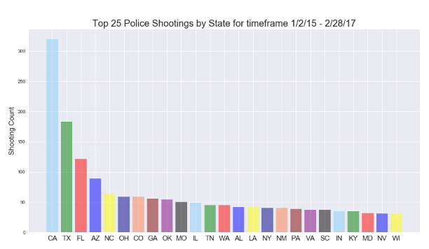
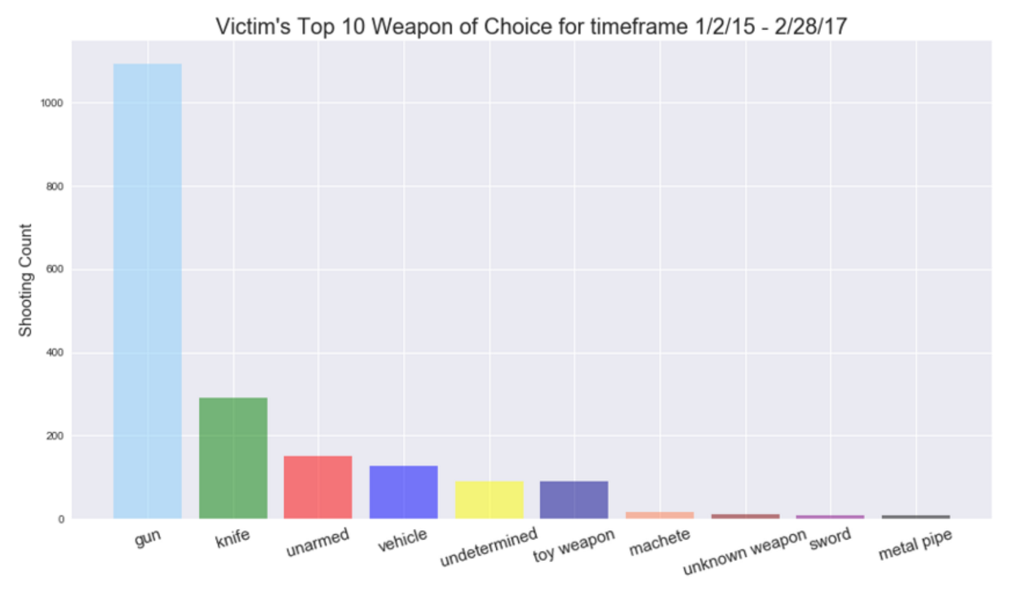
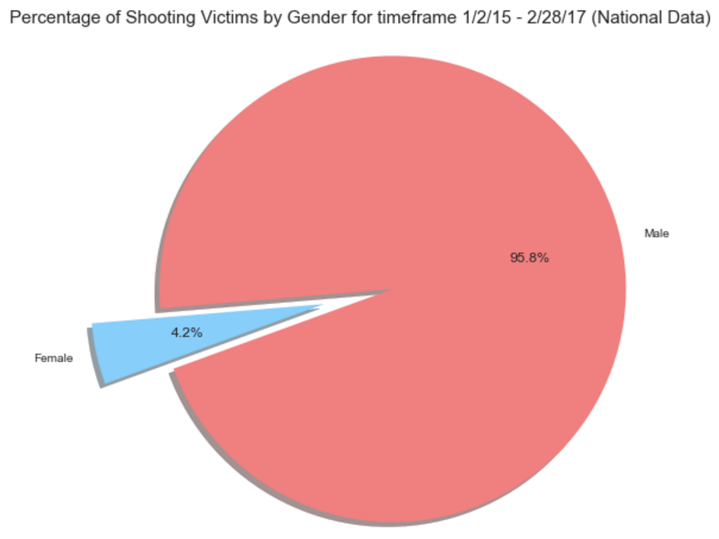
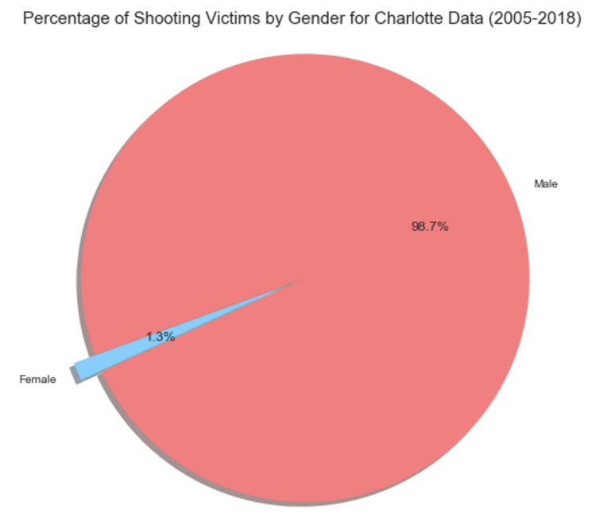
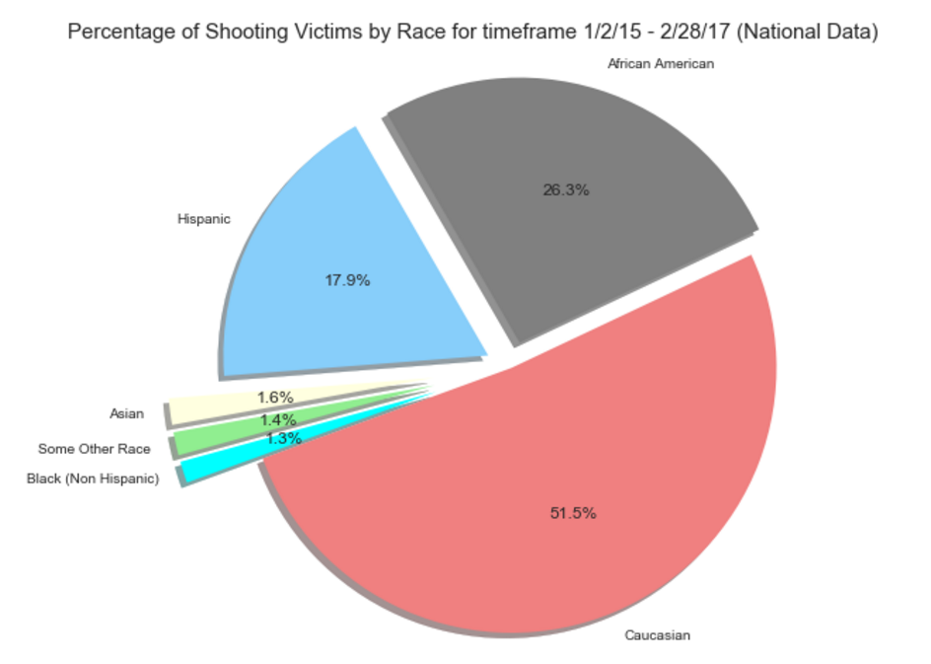
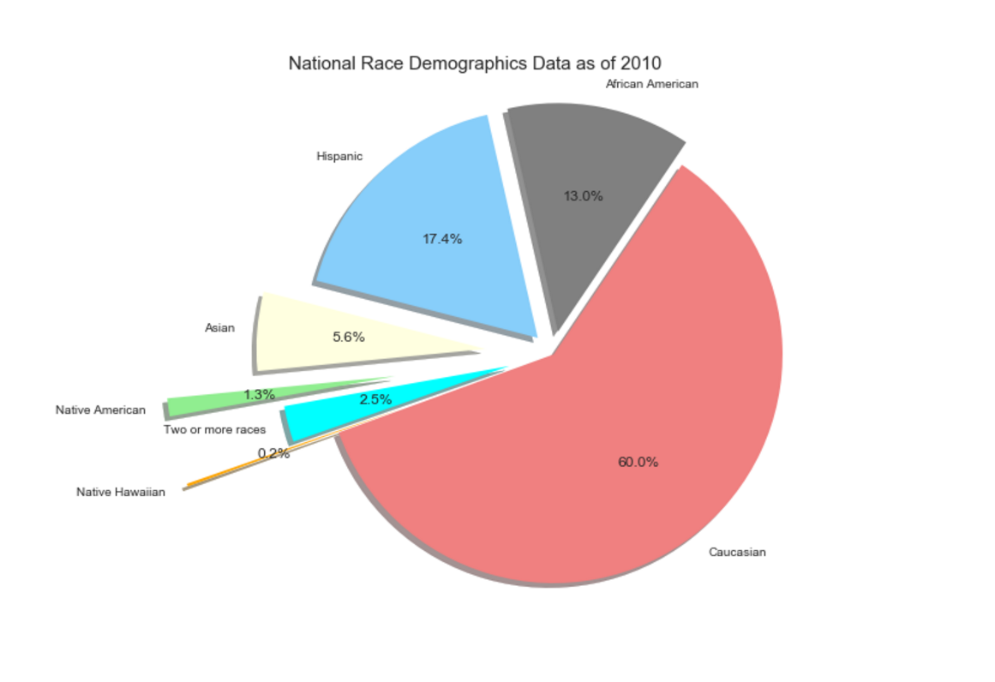
U.S. Shootings Statistics
Number of shootings by state
Victim’s weapon of choice
Victim’s by gender
Victim’s by race
Notes:
We wanted to compare stats at the national and Charlotte level so we pulled five concentration points with the data we had. The first is number of shootings by state. You can see that state X has the most followed by x. NC ranks in the top 10 at number x. The next is the victim’s weapon of choice. You can see guns far outweigh any other weapon of choice. The next is the victim’s gender. From the analysis we see male’s far outweigh females being shot. The net is victim’s race. Caucasians hold the title of being shot and killed the most, however when we compare to the national race demographic we find x. The final is victim’s age range. We didn’t expect this, but the age range of 31 – 40 was highest. The tools I used to prepare this data is x.

Slide 7
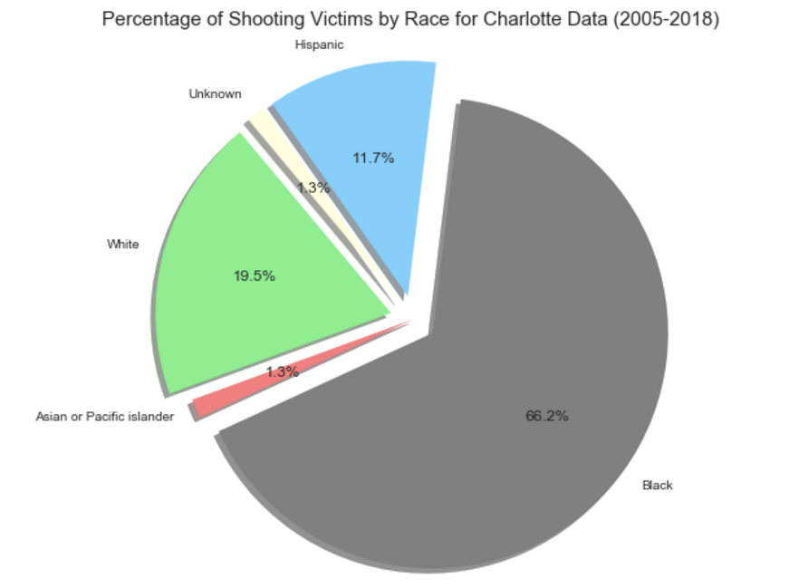
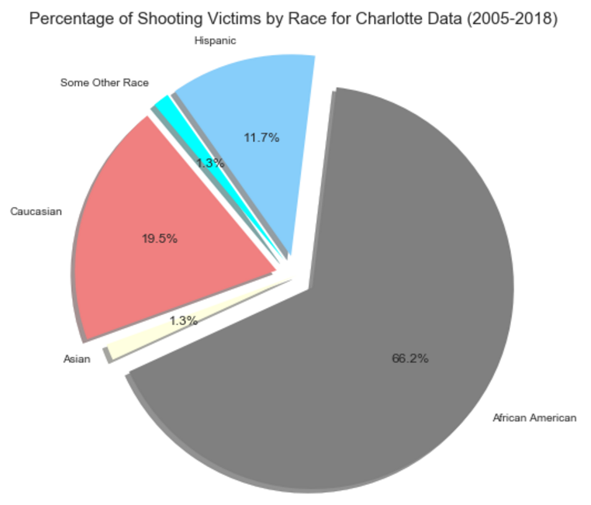
Charlotte shootings v. Demographics

Slide 8
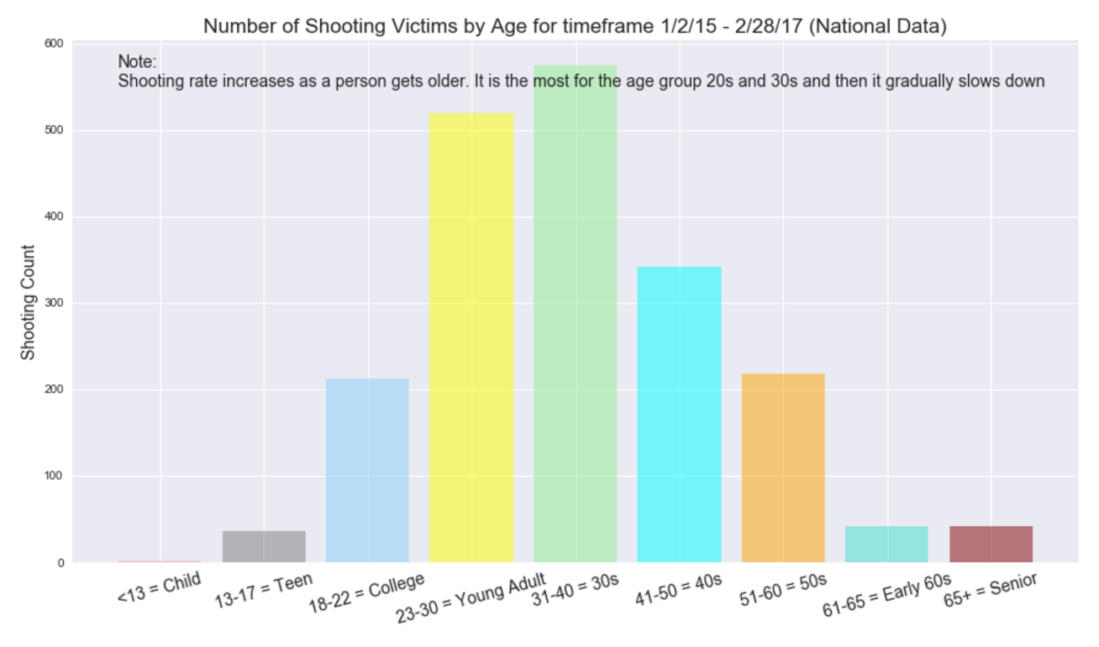
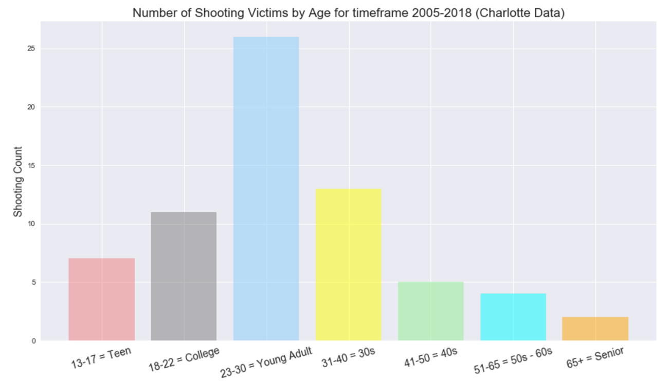
National v. Charlotte Police shootings
V.
Notes:
This answers our first question of how does Charlotte shootings by age compare to the national level? You can see that Charlotte shootings spike in the 20’s, but on a national level they max out in the 30s?

Slide 9
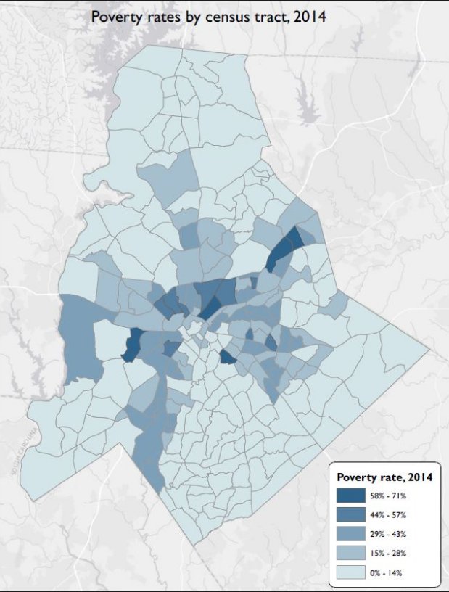
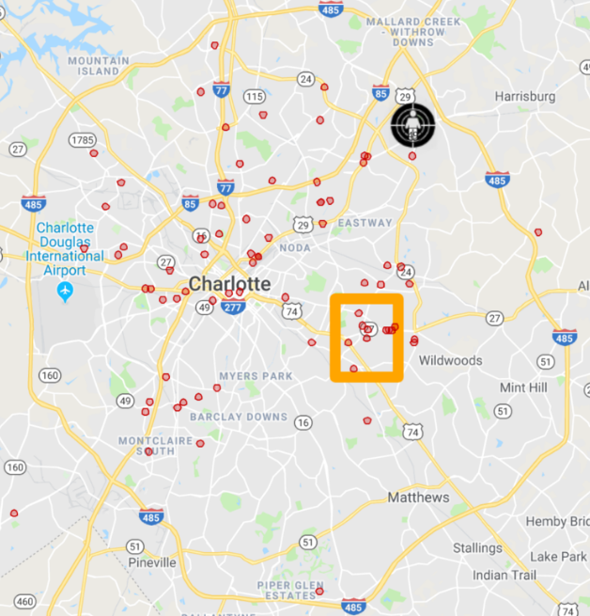
Are wealthy neighborhoods safer?
Zero shootings!
“The Wedge”
Notes:
Update anumations

Slide 10
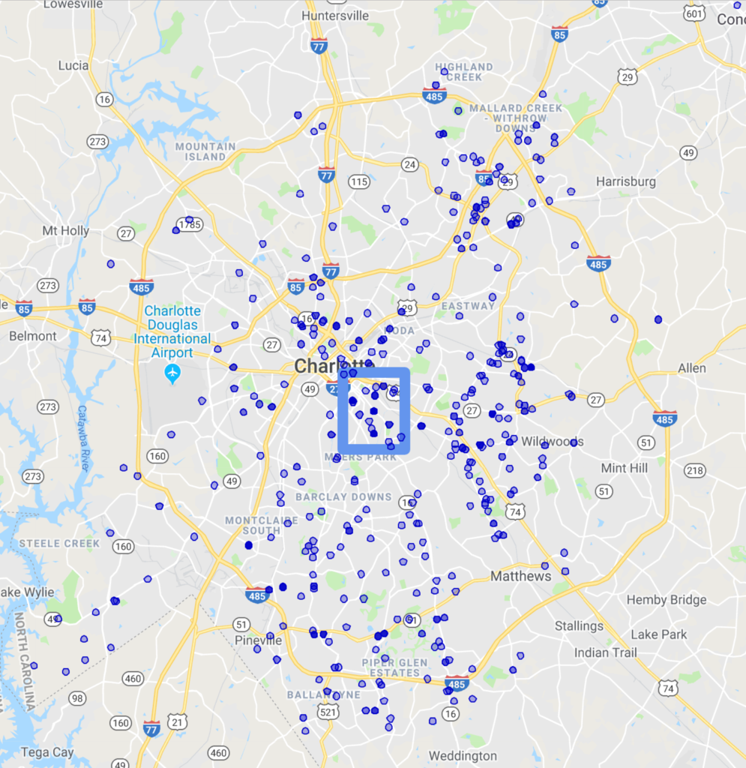
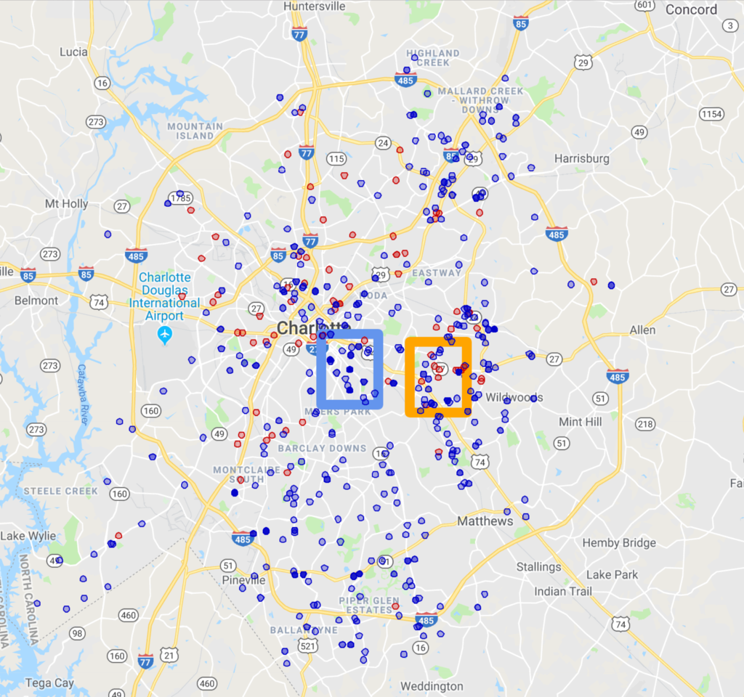
Community Police interaction v. Shootings
Notes:
There are 76 outreach events in the concentrated window.
There are 10 shooting events in the conentrated window.

Slide 11
Conclusion
Crime rate does increase as people approach their 20s – 30s and decreases as they get older.
Yes, wealthier neighborhoods do have less crime.
Inconclusive. There is no direct connection between increased police interaction and police shootings.
Notes:
Hypotheses:
1. Crime rate increases as people approach their 20s to 30s and decreases as they get older (proved)
2. Wealthier neighborhoods have less crime. (proved)
3. Areas where police interaction within the community is robust will have a decrease in police shootings? Why – because the officers are invested in the community. (not so much bc data was inconclusive)

Slide 12
Shootings near you!
Show Keith Lamont shooting using Colleen’s code
Address: 9400 Lexington Circle Charlotte, NC
Data cleansing - I had to take " Pleasant Hill Baptist Church (517 Baldwin Avenue) from 6:30 PM-8:00 PM." (which was in the original data set) and turn it into "517+baldwin+avenue,+Charlotte,+NC" in order to build a geocoding request from Google. I used Google geocoding to x.
Notes:
Data cleansing - I had to take " Pleasant Hill Baptist Church (517 Baldwin Avenue) from 6:30 PM-8:00 PM." (which was in the original data set) and turn it into "517+baldwin+avenue,+Charlotte,+NC" in order to build a geocoding request from Google. I used Google geocoding to x.

Slide 13
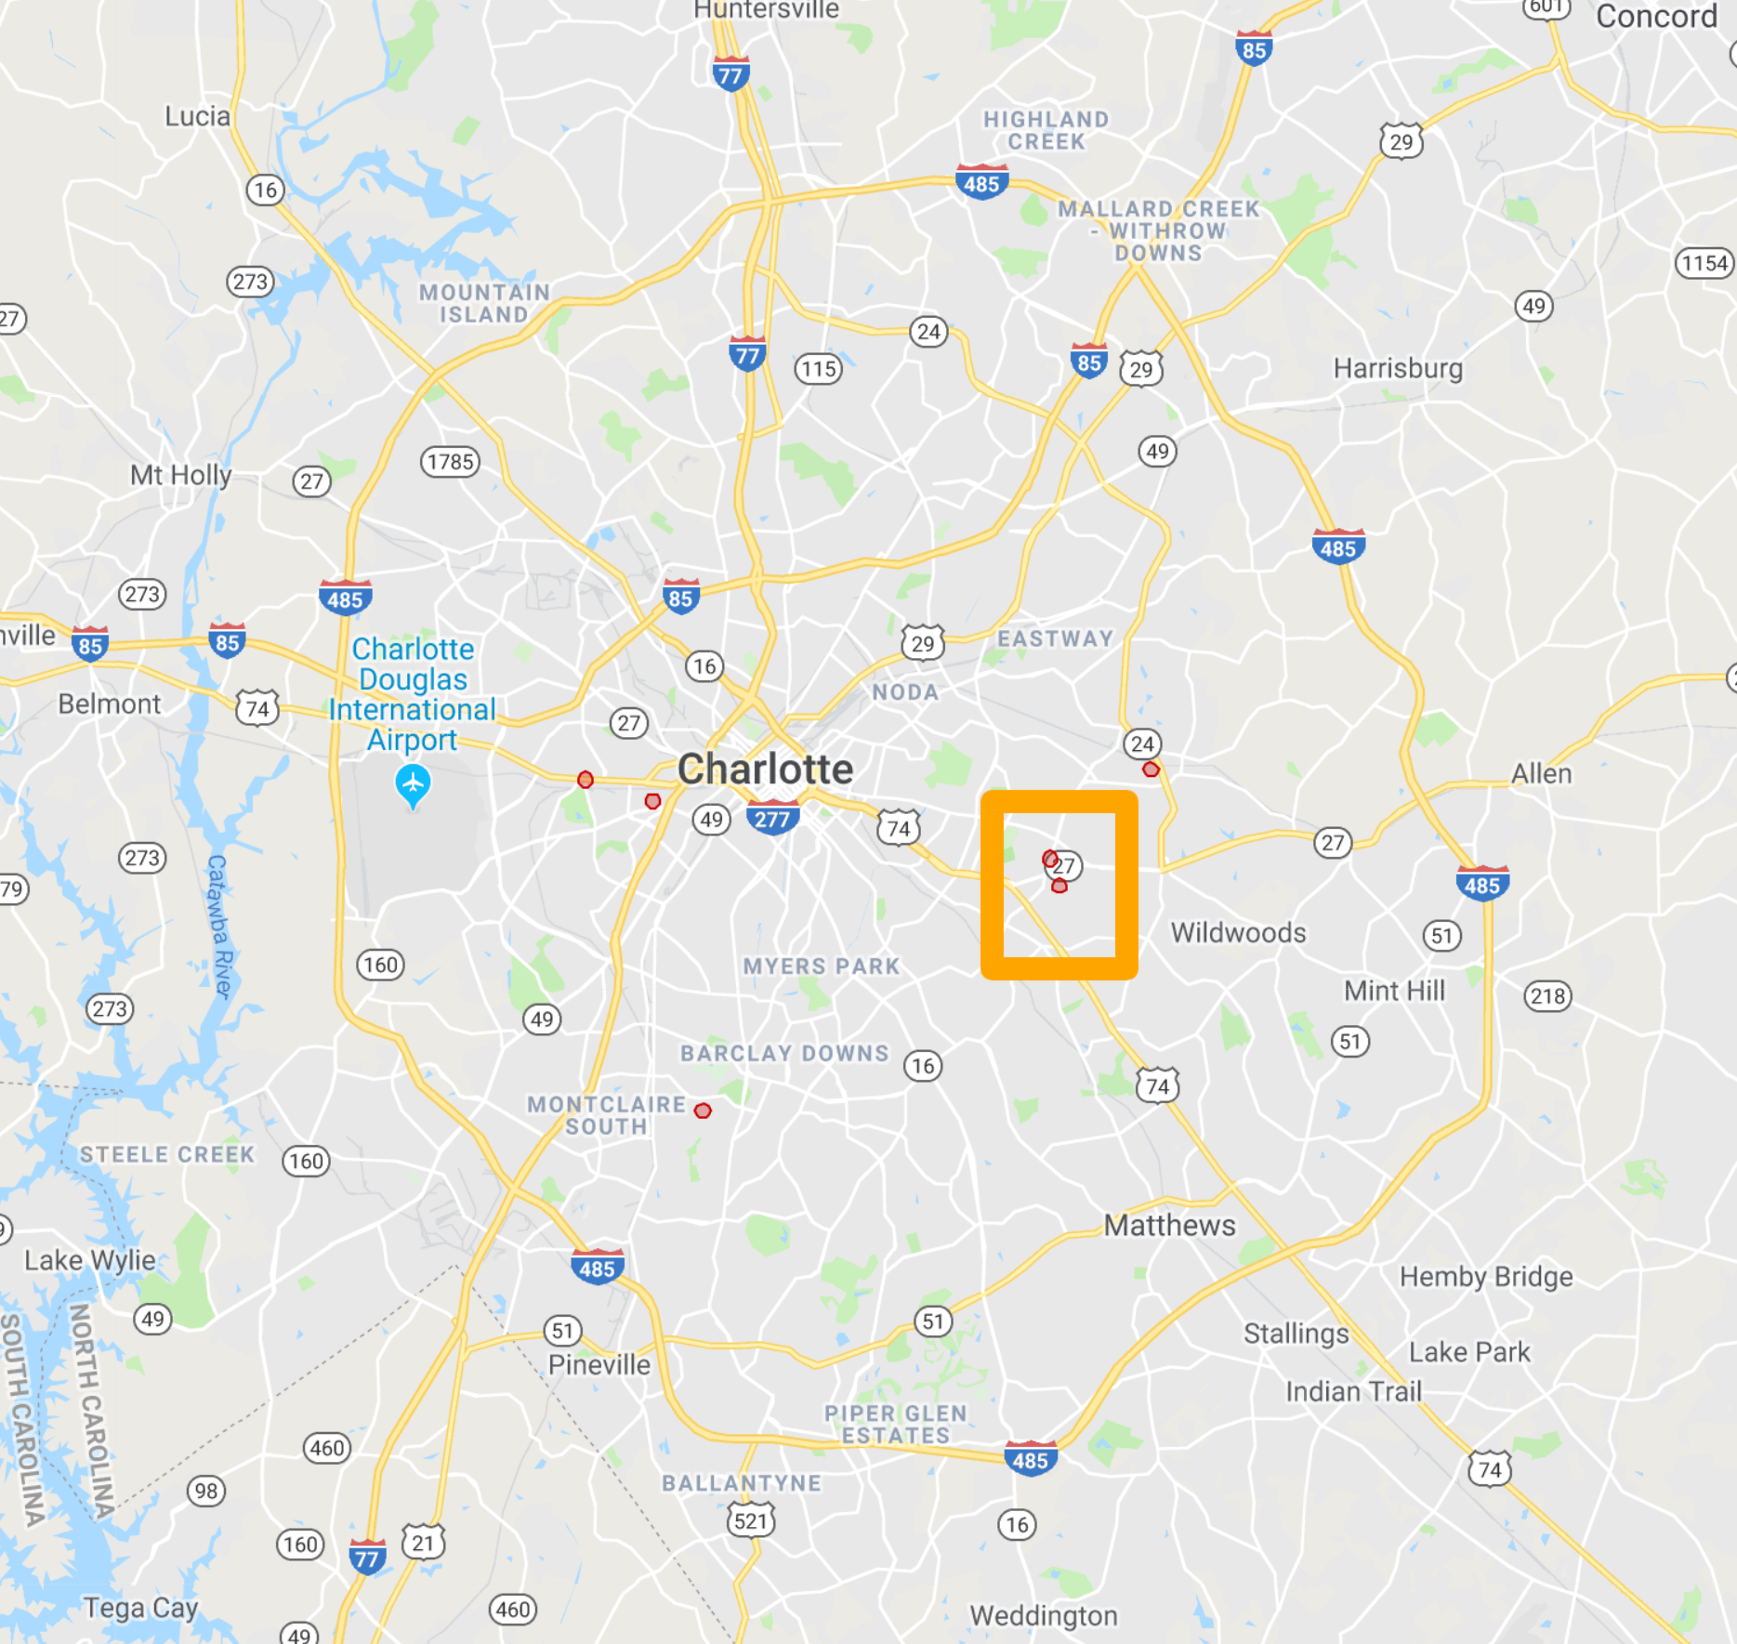
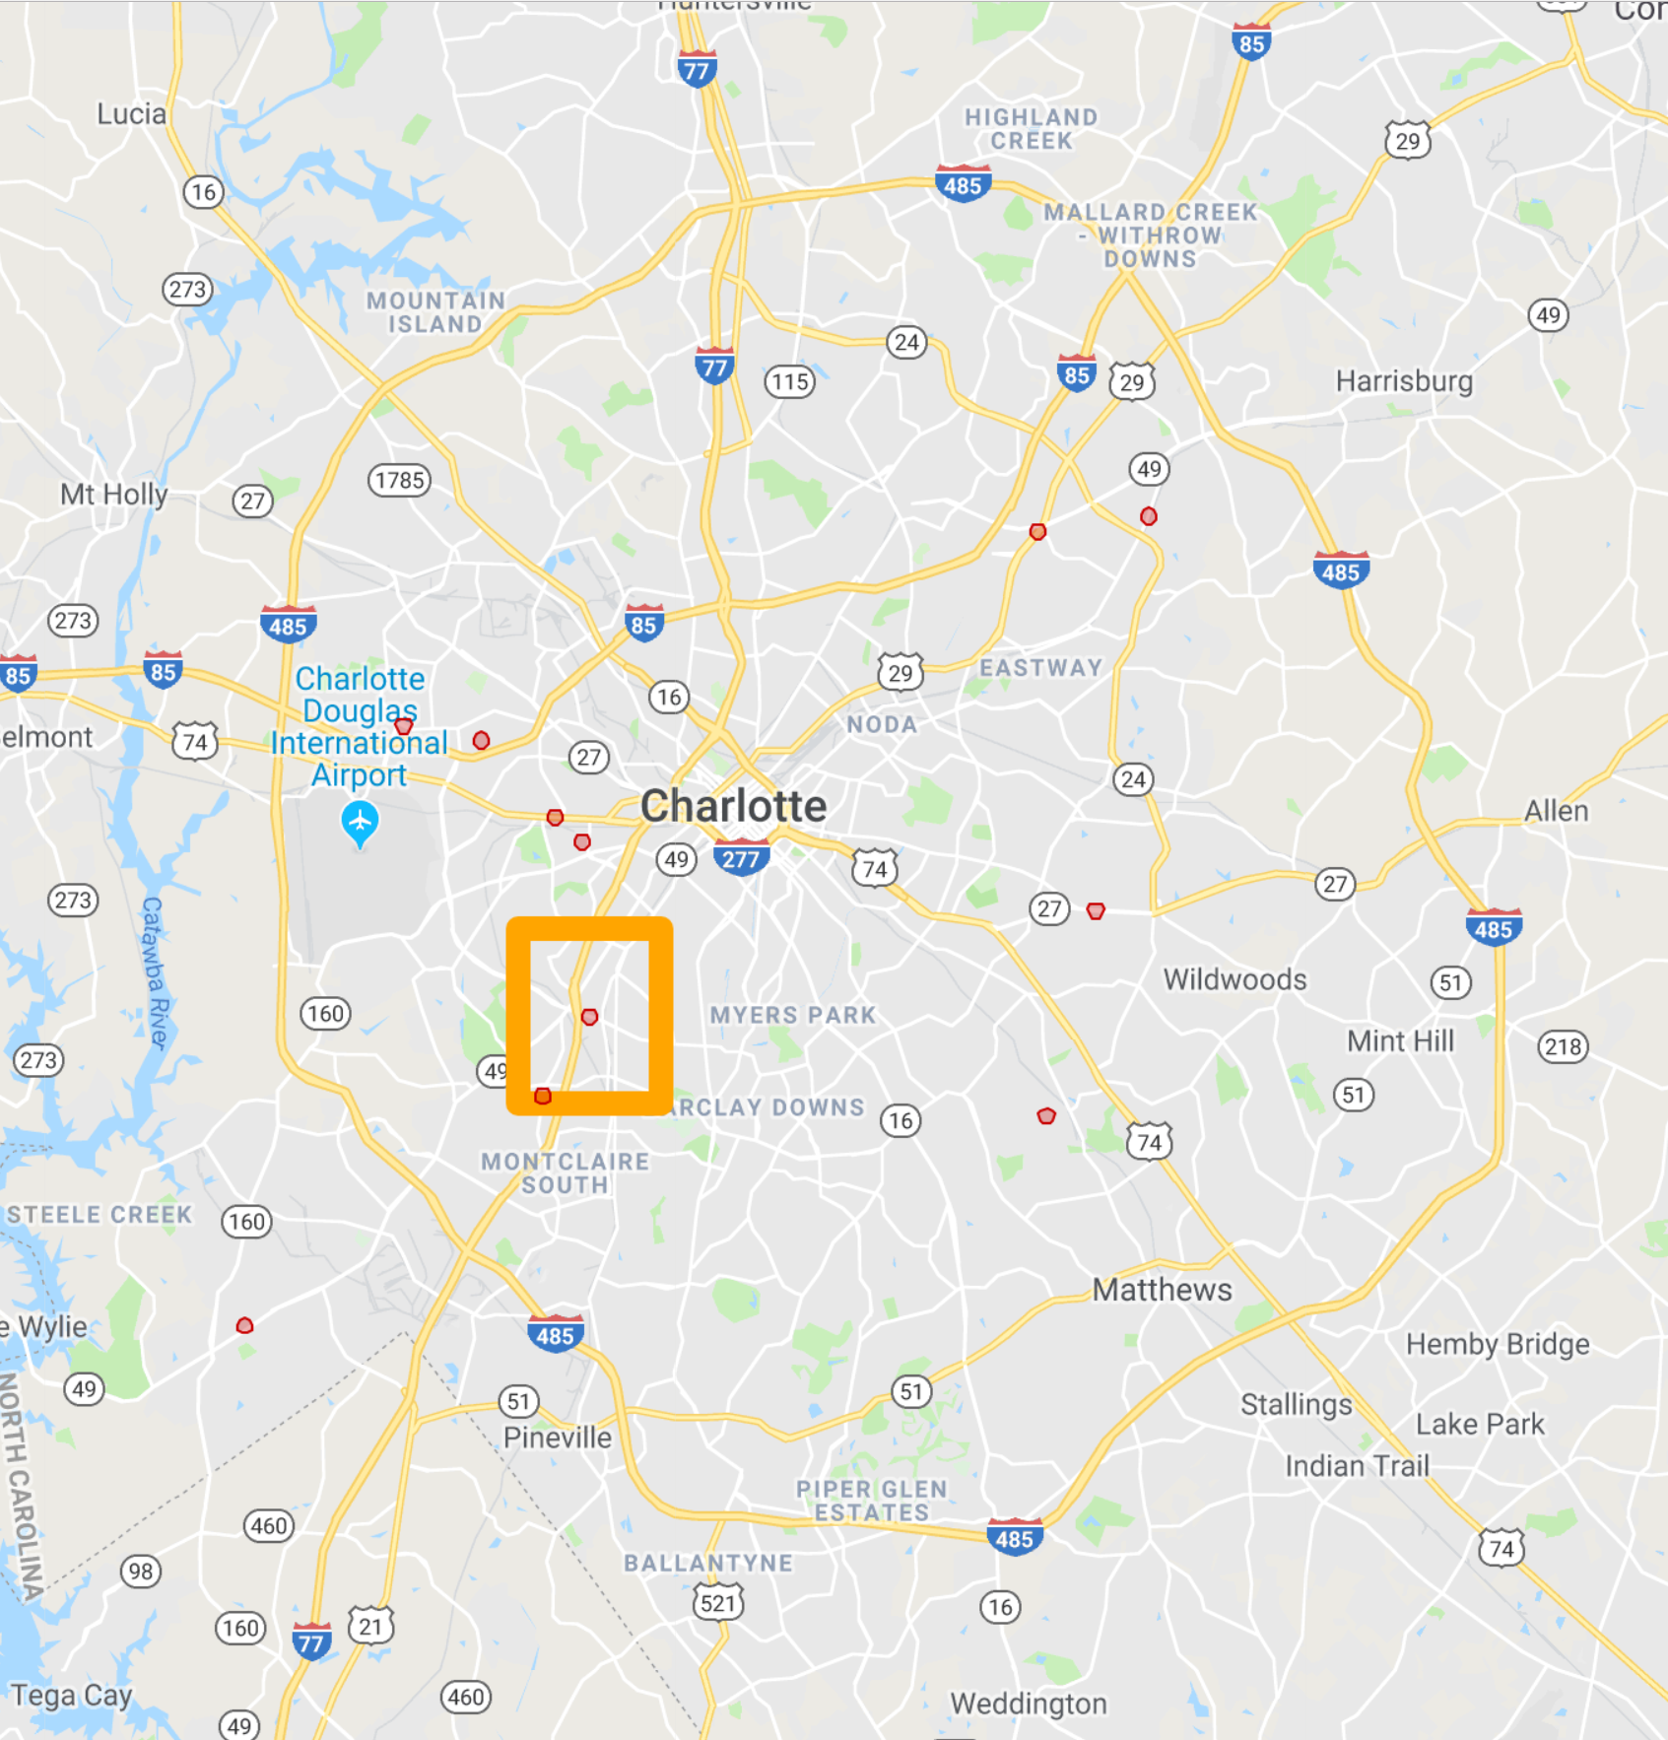
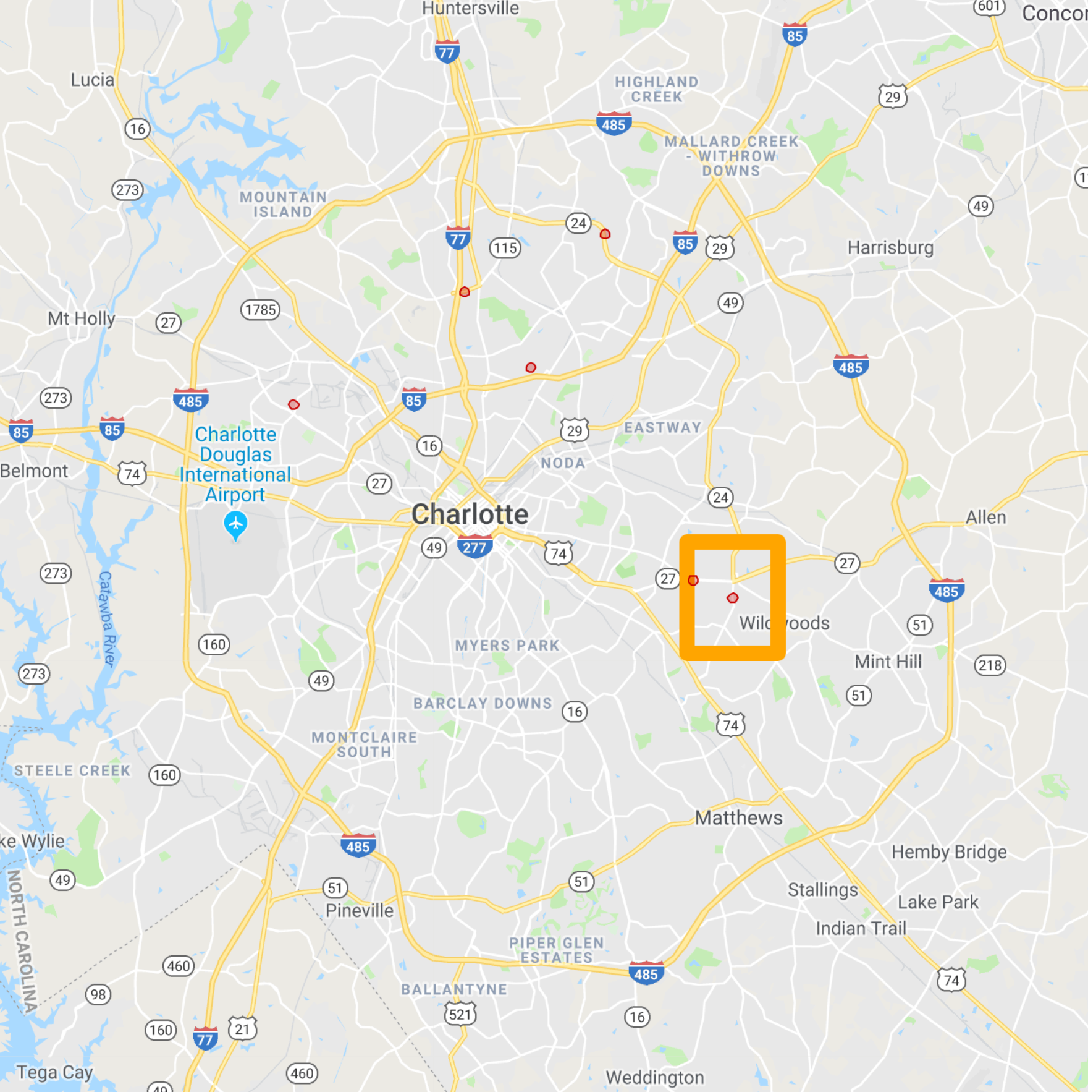
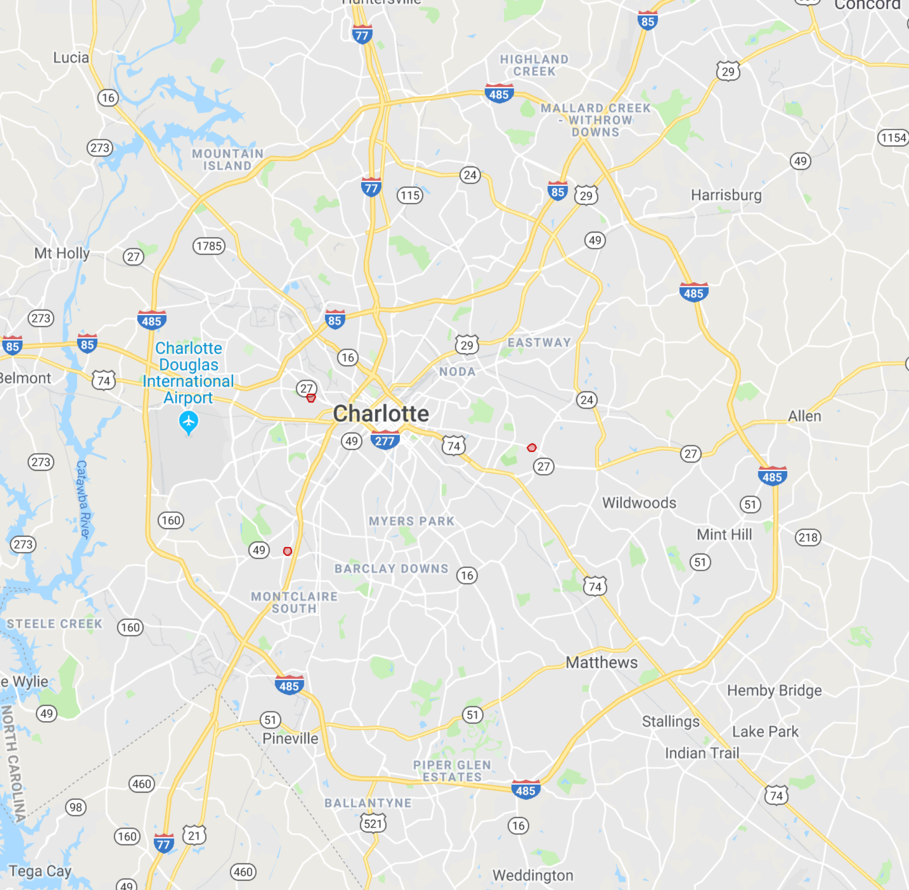
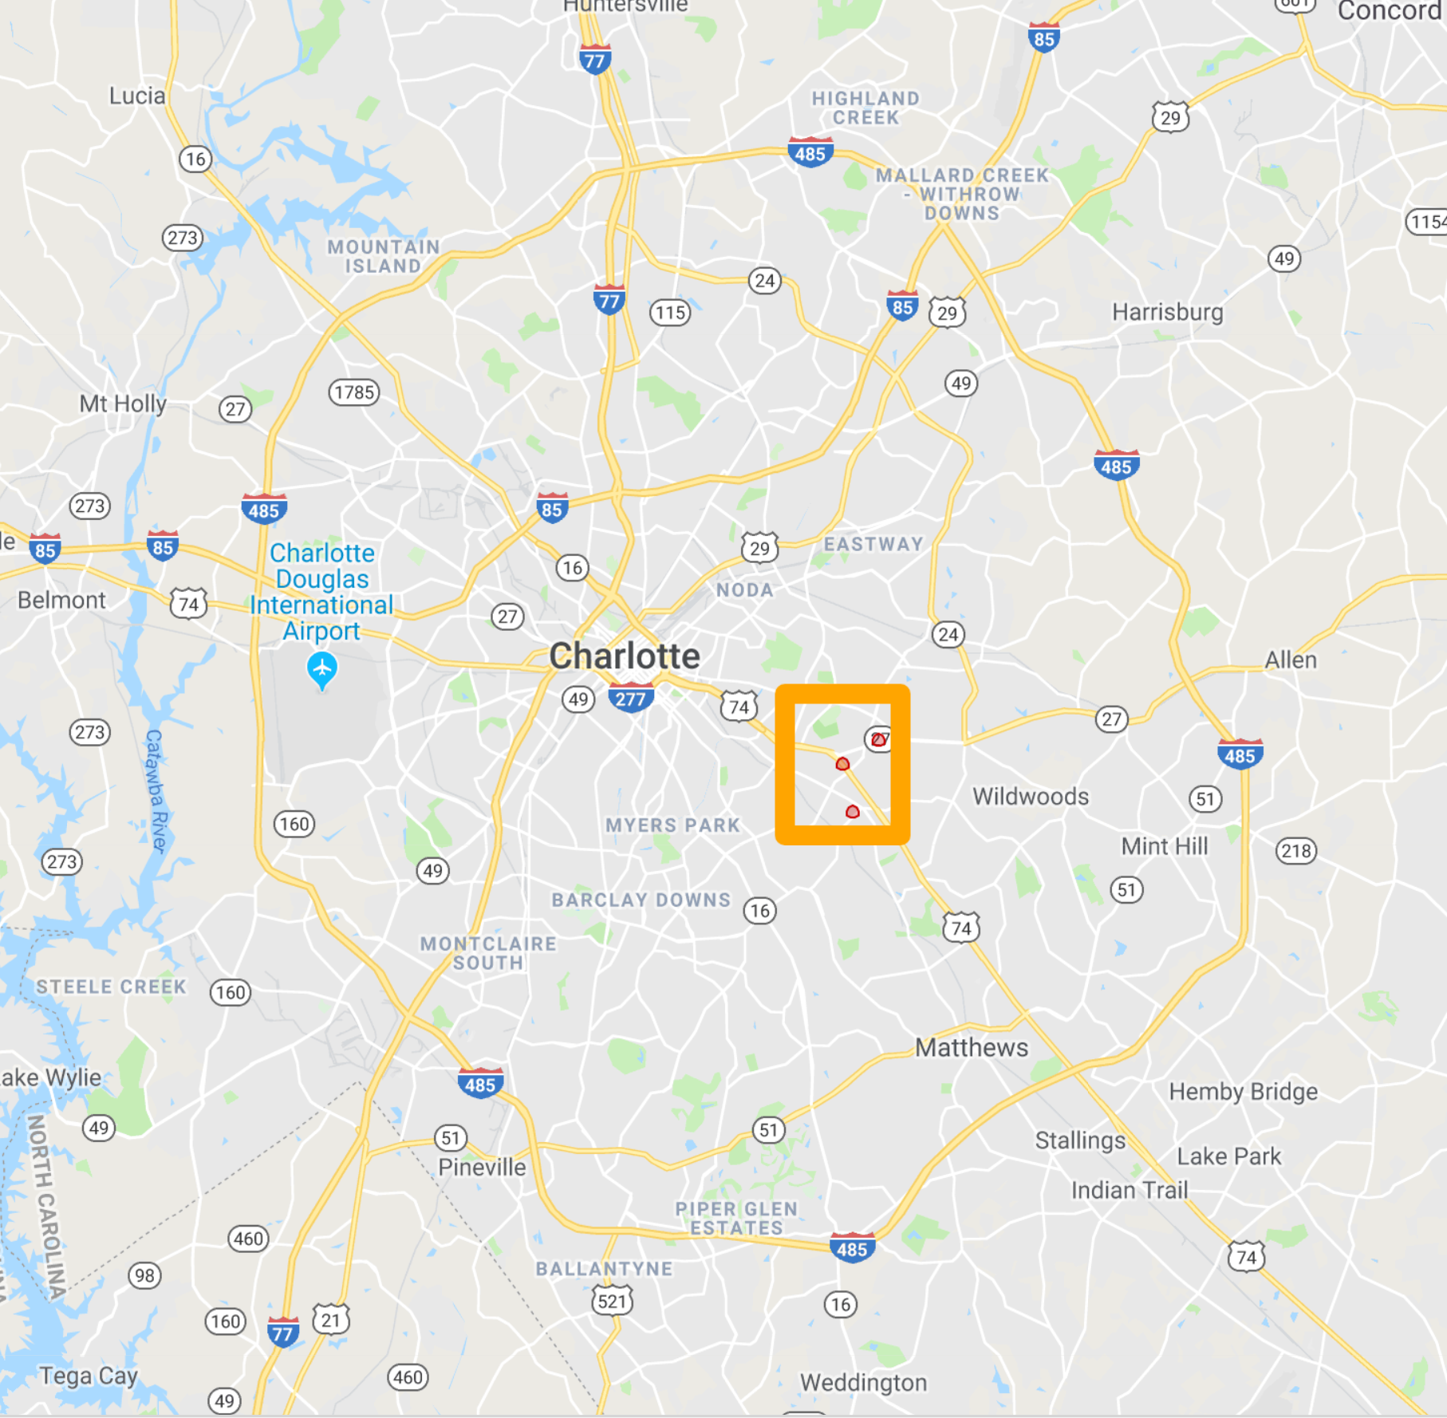
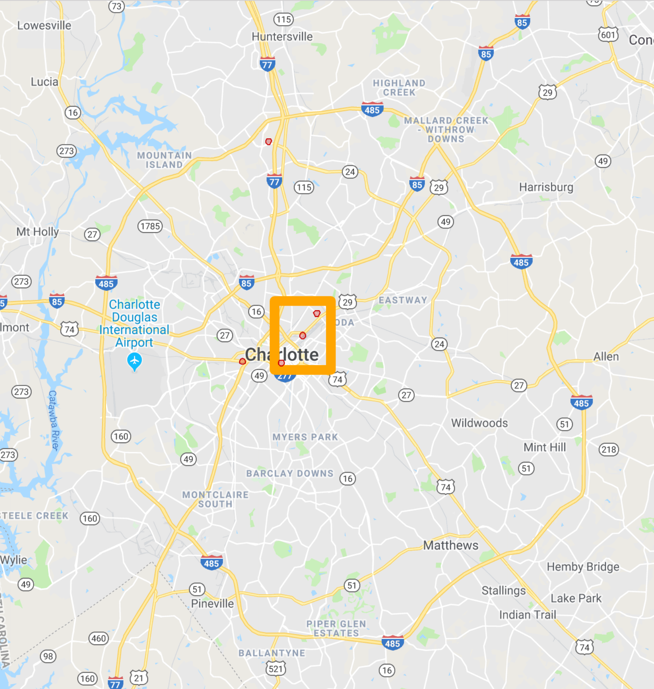
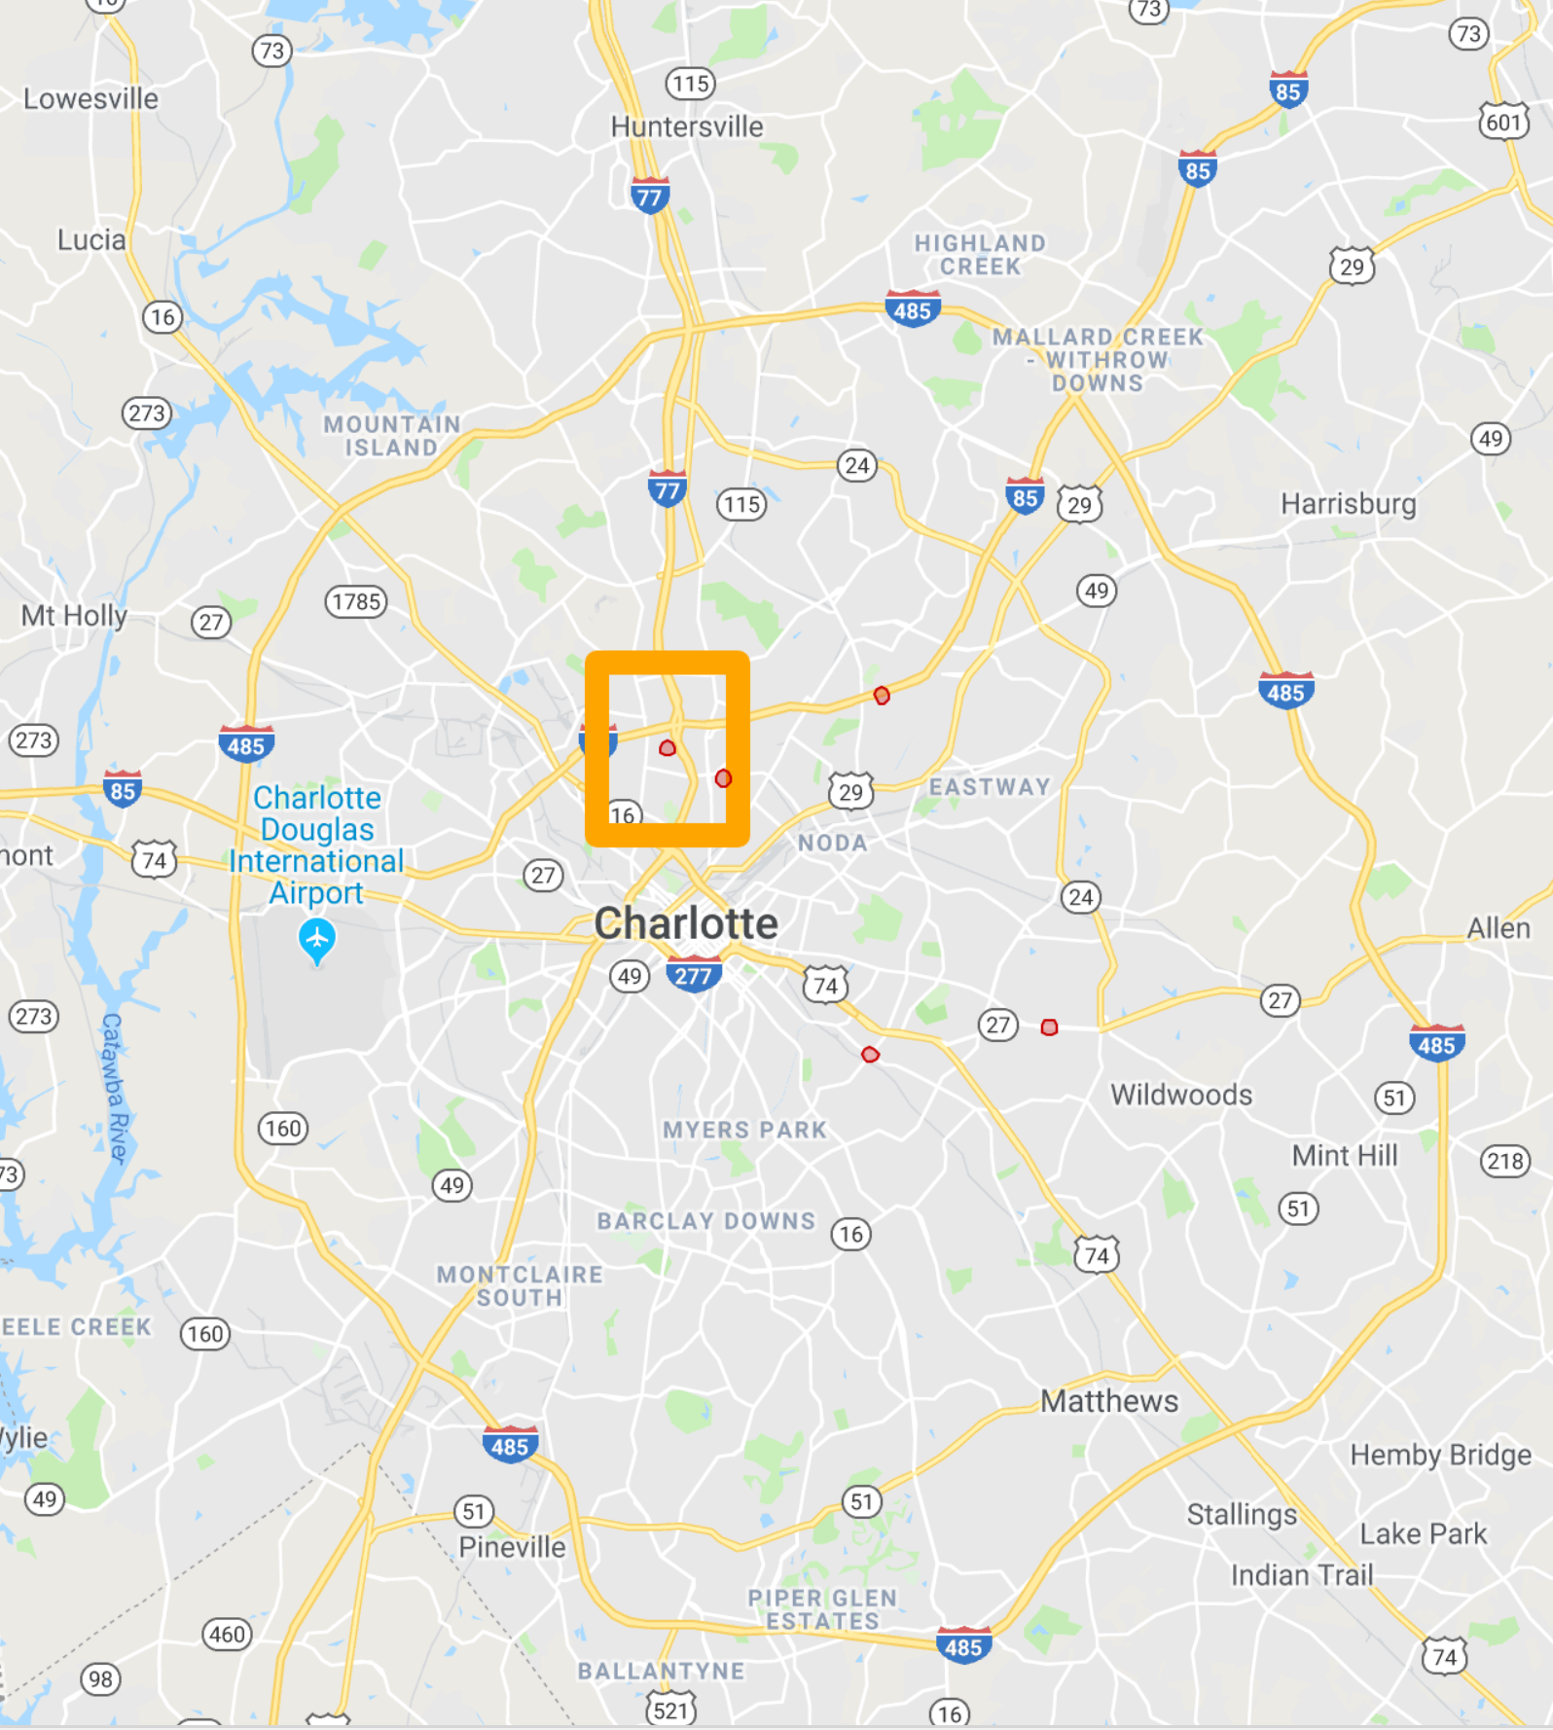
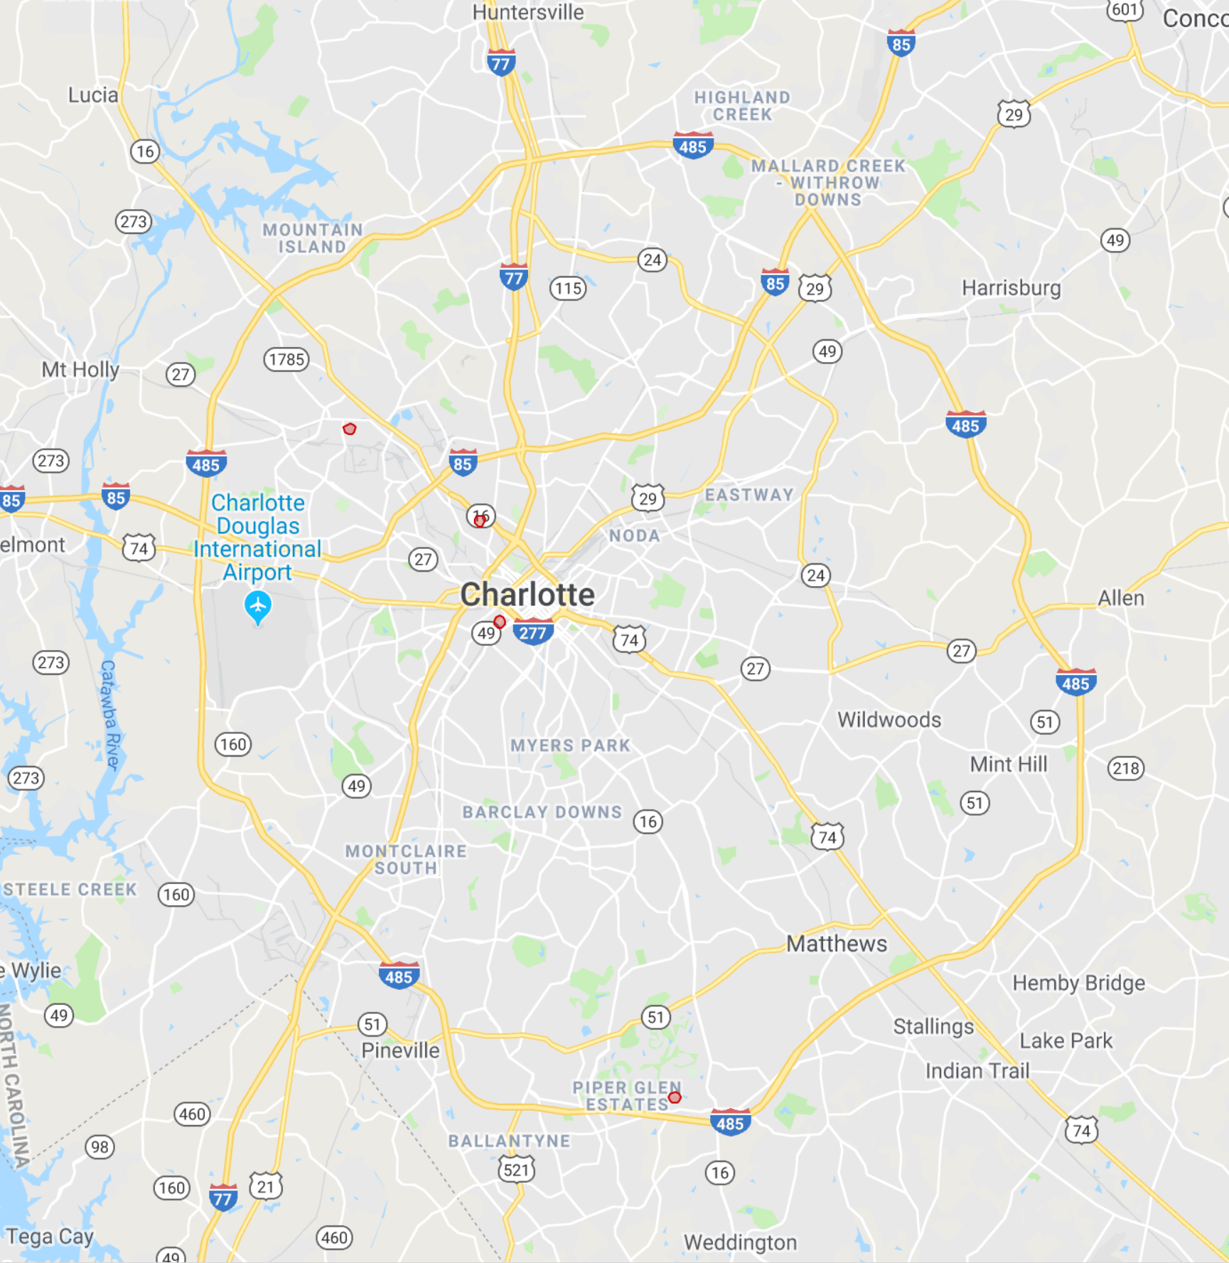
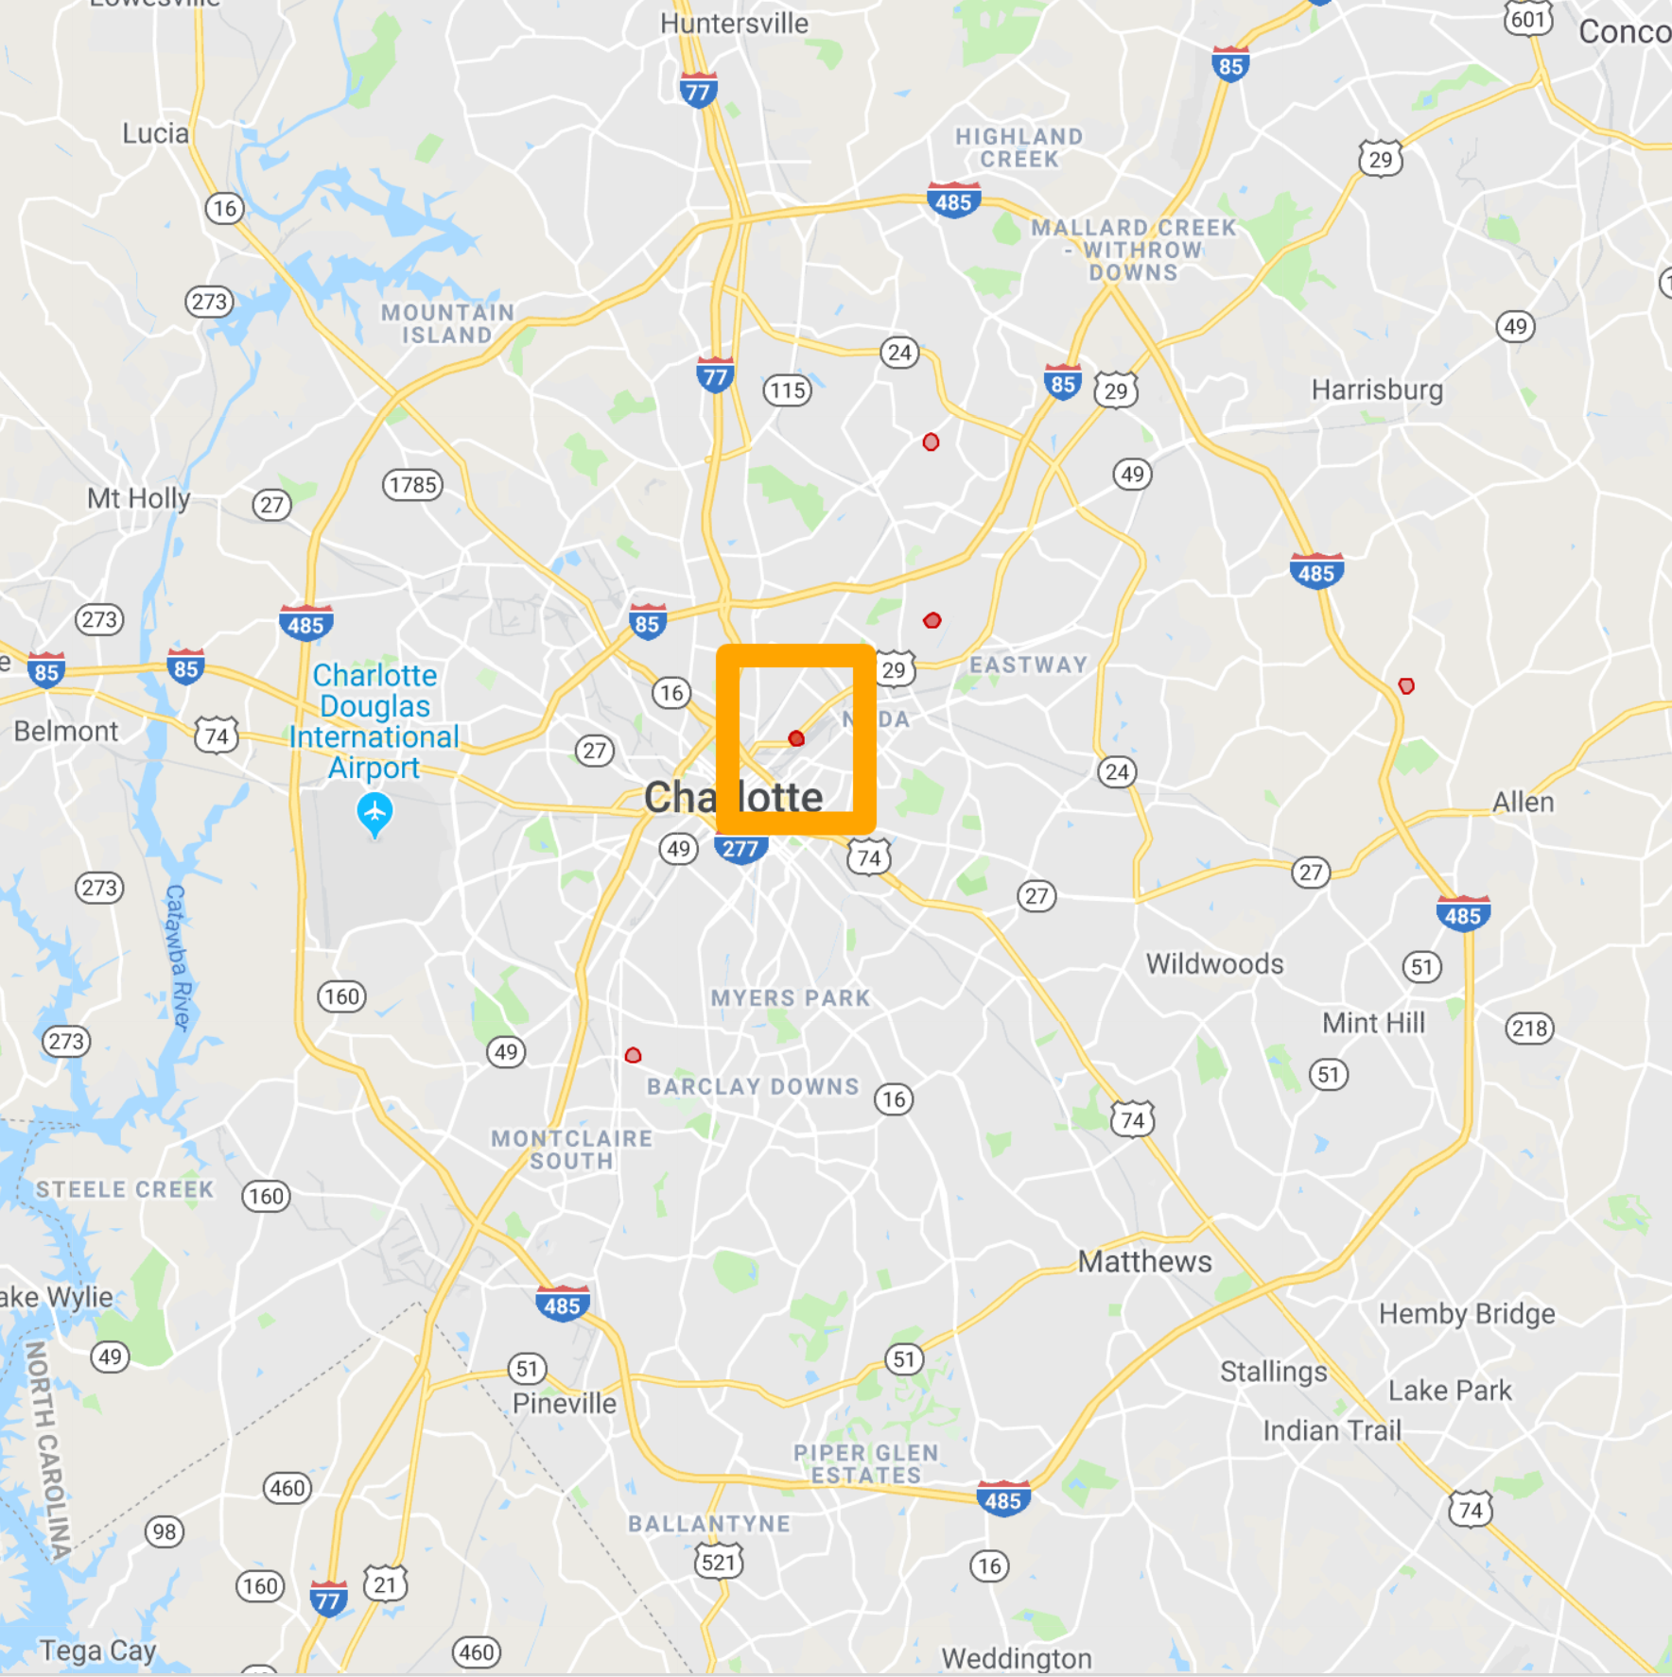
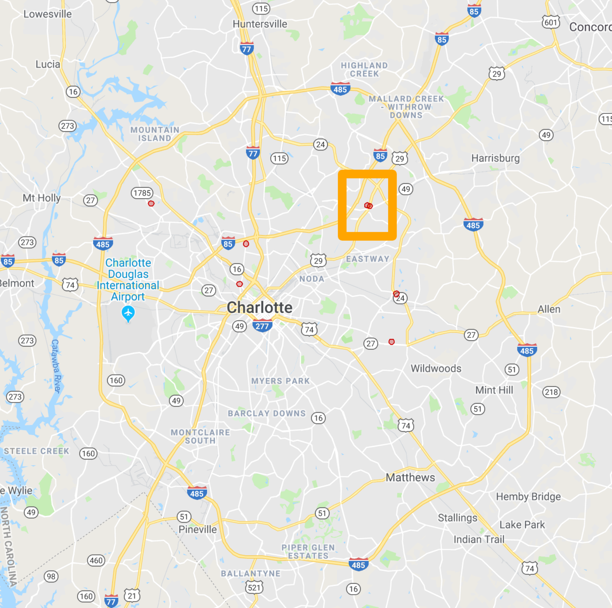
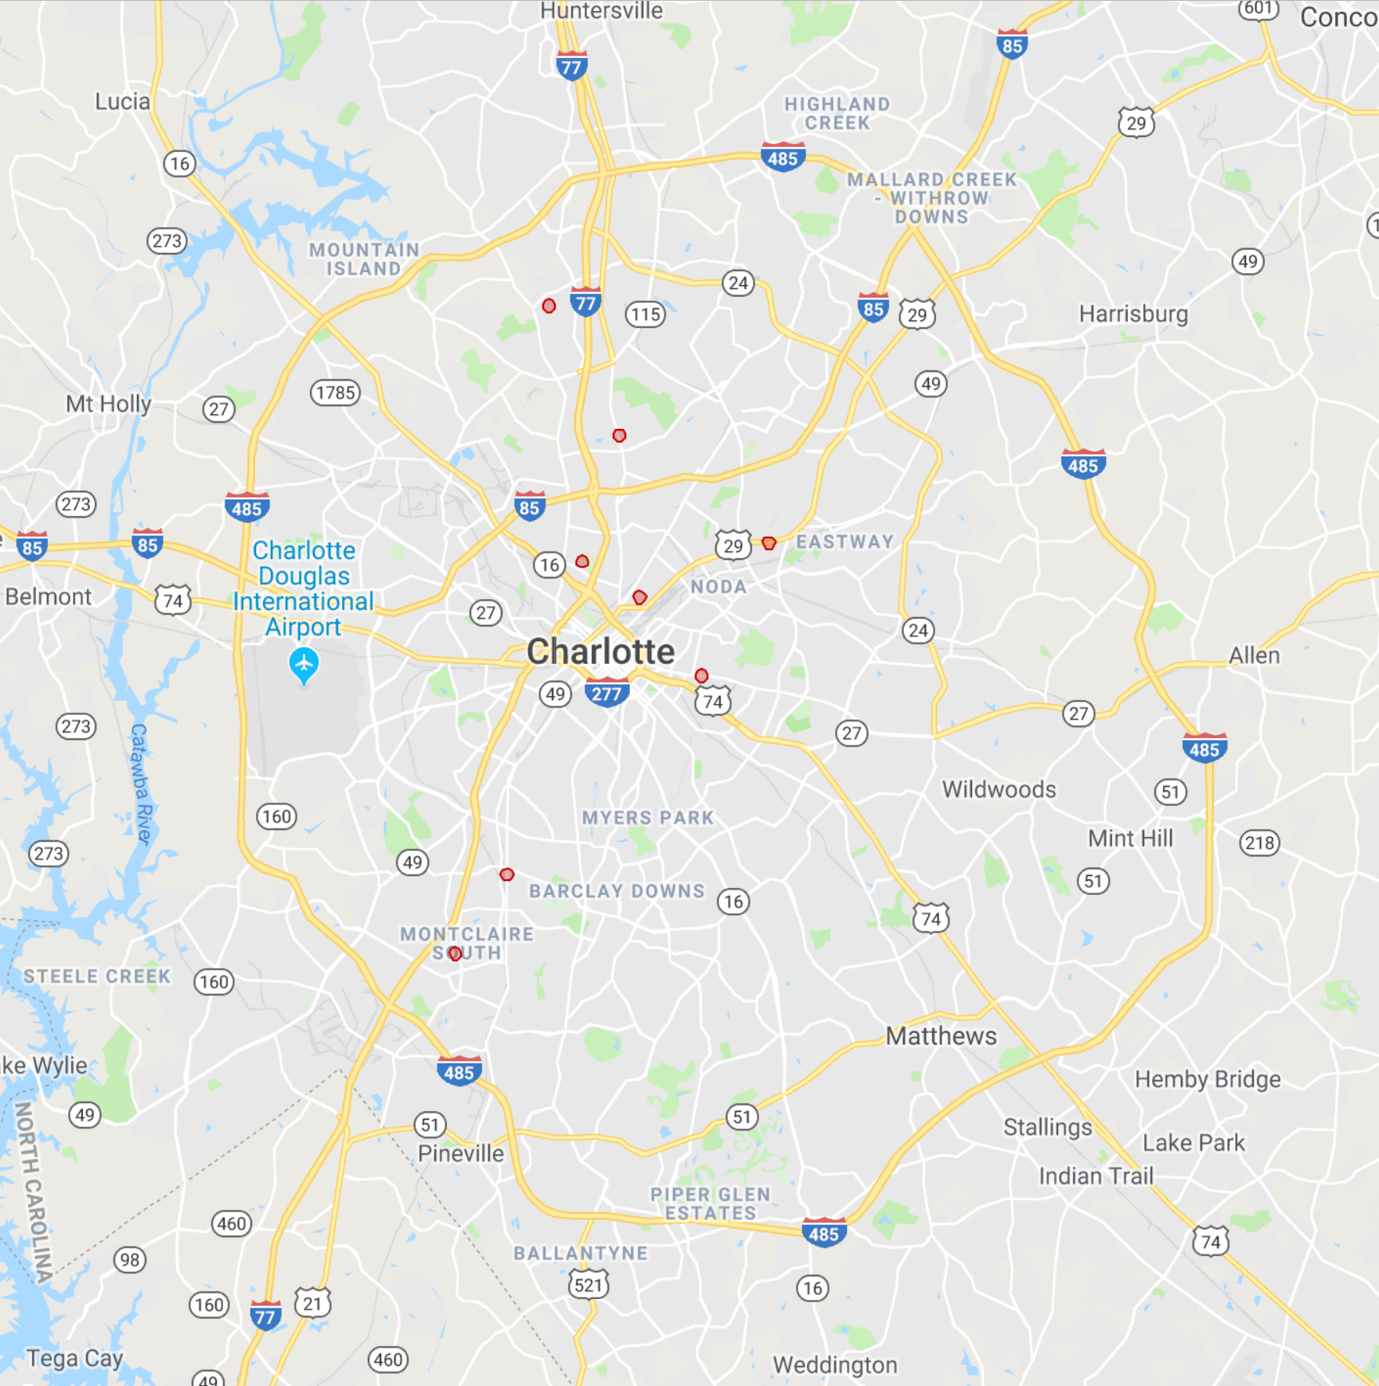
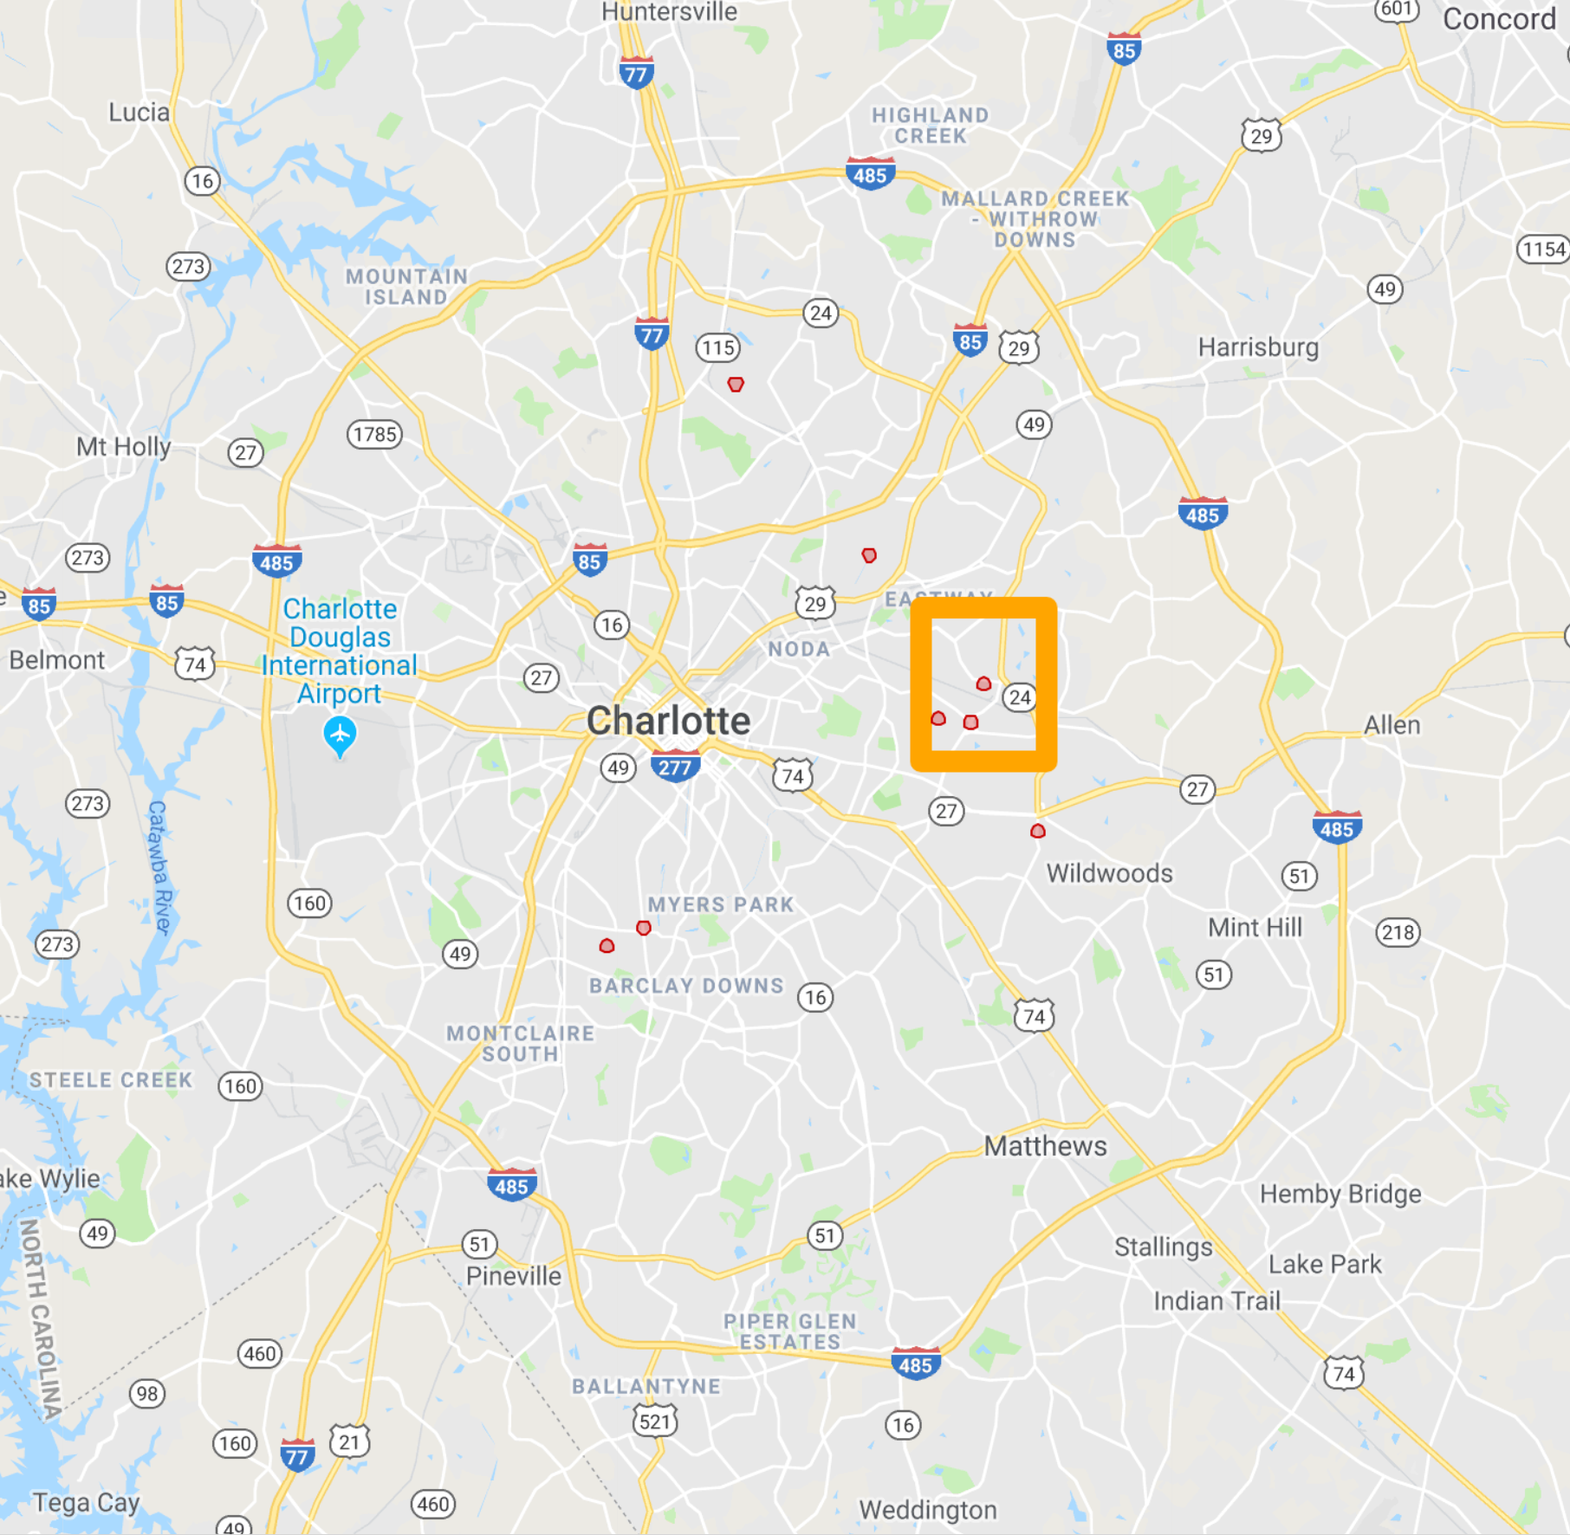
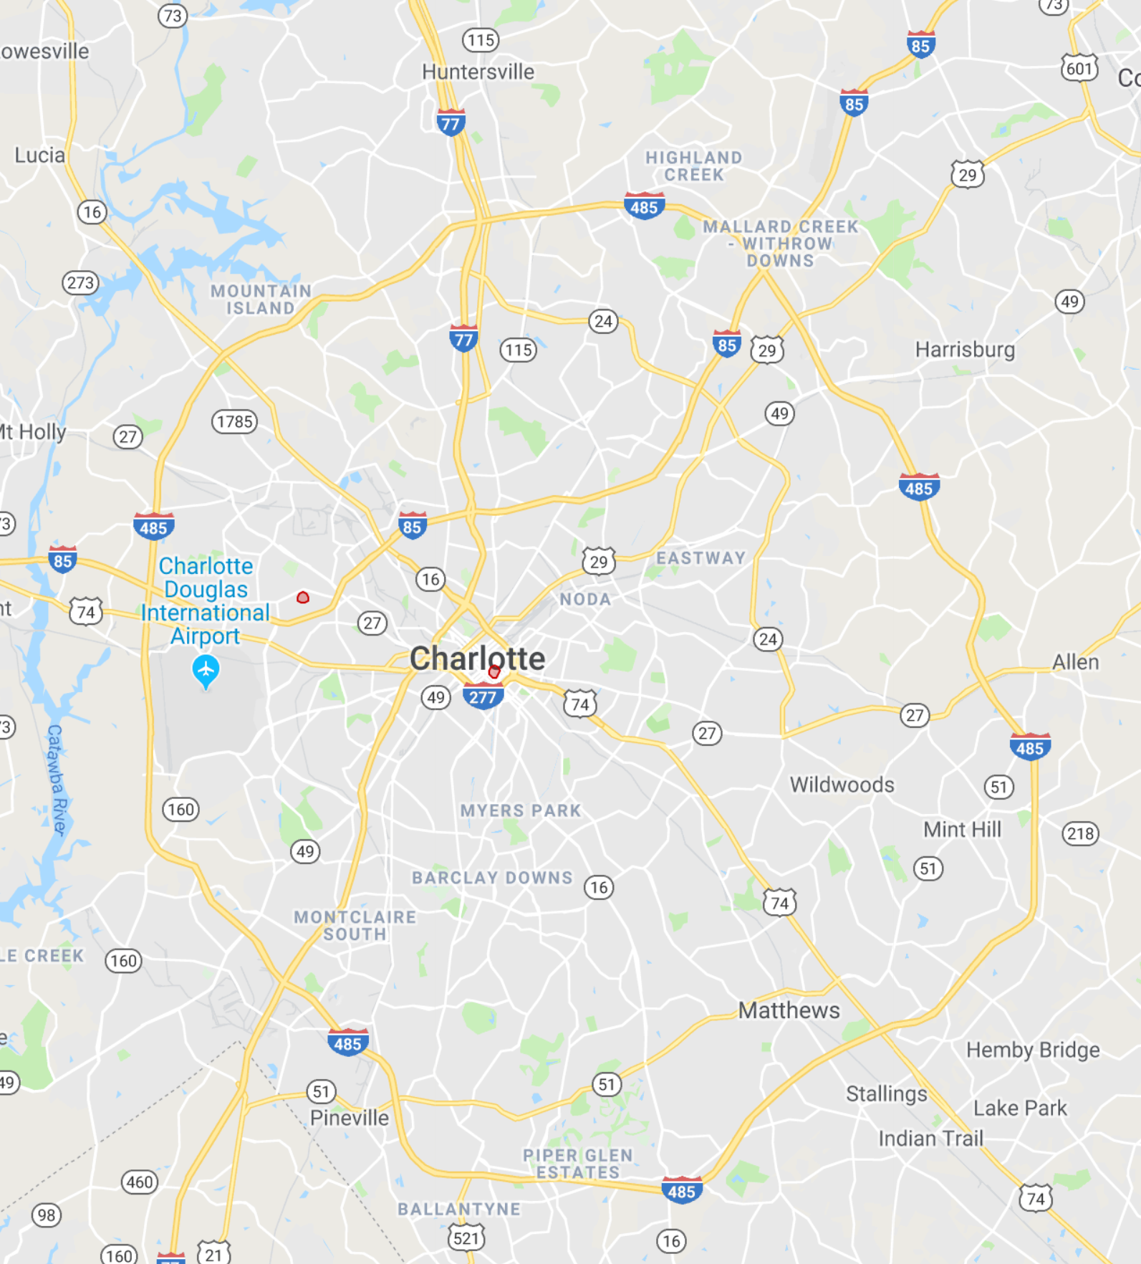
Shootings over time…
2005
2006
2007
2008
2009 – no data
2010
2011
2012
2013
2014
2015
2016
2017
2018
Notes:
Shootings over time show us x. In order to get this data we used the X method.

Slide 14
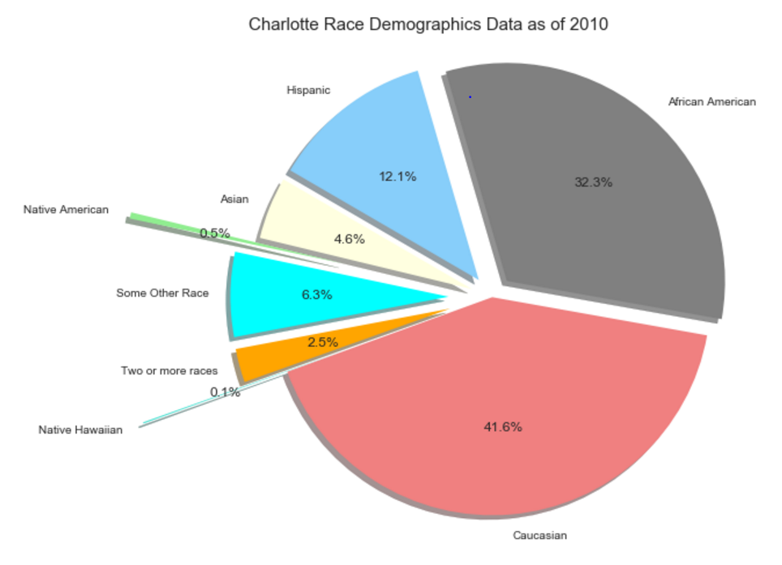
Charlotte Statistics
Resulting injury (pie chart) – fatal, non-fatal or other Corey
Victims by gender (pie chart) – Deanna
Victims by race (pie chart) – Deanna
Victims age range (<13 = Child, 13 – 17 = “Teen”, 18 – 22 = “College”, 23 – 30 = “Young Adult”, 31 – 64 = “Adult”, 65 – 87 = “Senior”; pie chart) Deanna
Officer Community Outreach (data cleansing by ignoring any words before the first address number; delete rows without address’) - Colleen
Map – compare shooting locations to community outreach locations - Colleen

